Slide 1
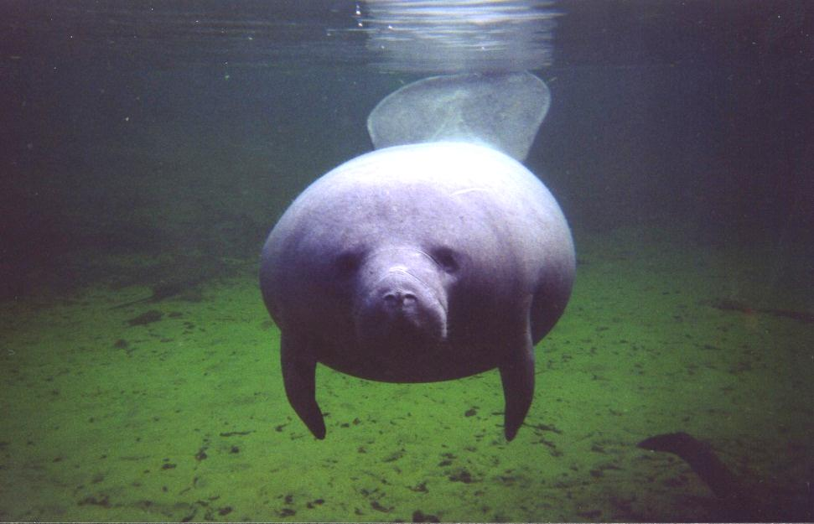
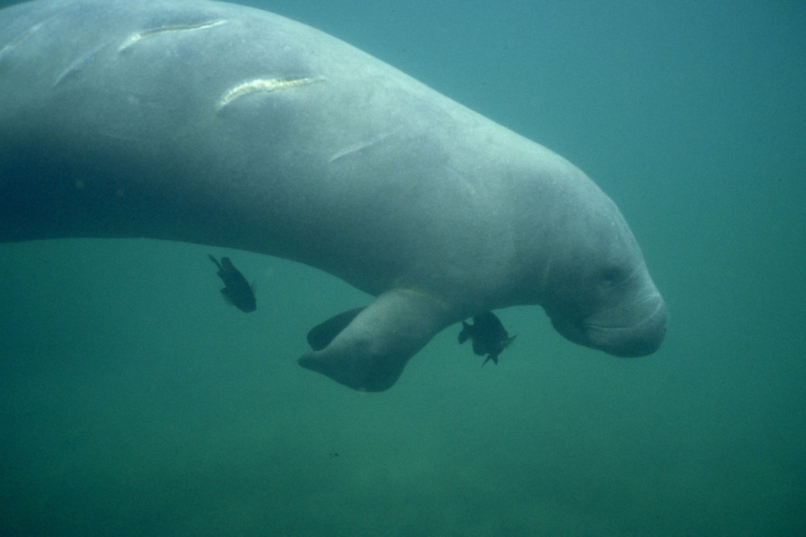
Our Manatees Need Your Help!
In the spring and summer months, manatees are present in the waters around Hilton Head Island
These endangered marine mammals are 8-13 feet in length, feed on aquatic vegetation and live to an average age of 40 years
Females have 1 calf every 2-5 years; the calf is dependent on mom for about 2 years
Manatees are often found in shallow water or resting at or just below the surface and are slow movers, susceptible to boat strikes---see propeller scars on manatee at right
Feeding them or giving them water from a hose encourages them to stay around marinas or boats in open water where boat strikes are more likely---and it is a violation of the federal Marine Mammal Protection Act
Kelly Young
USGS
USGS
Please don’t feed or water our manatees!

