Slide 1
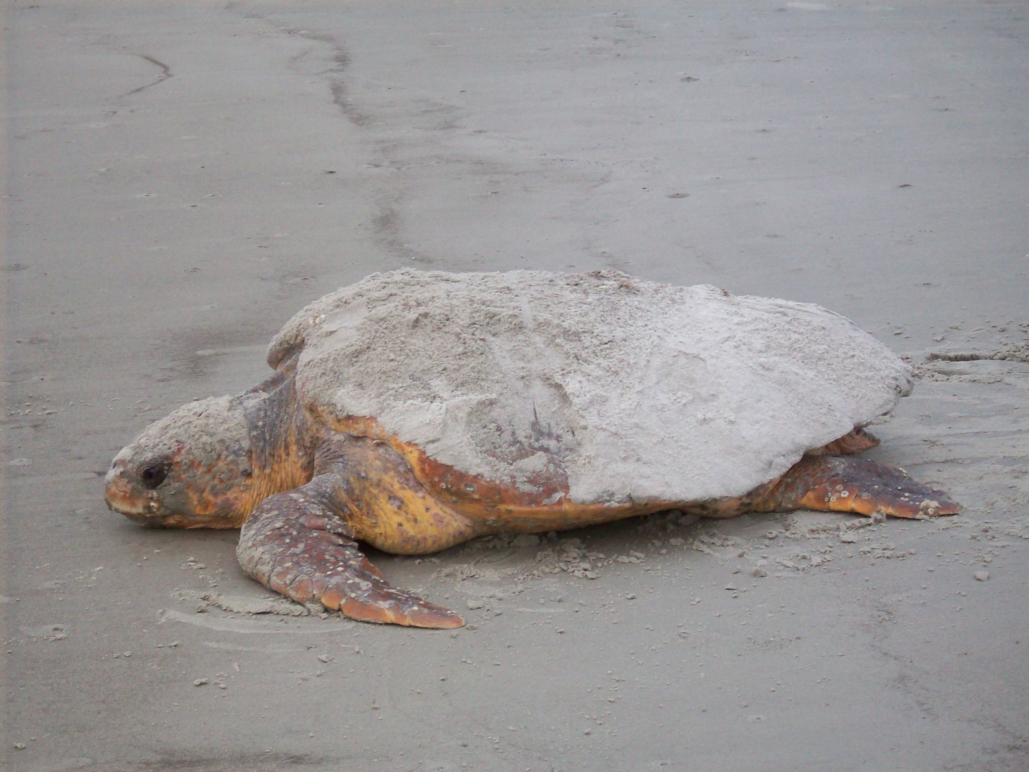
We Treasure our Sea Turtles
Please Help Protect Them!
Turn off ocean-facing lights by 10 pm from 1May-31 October (it’s the law)
After playing in beach sand, return beach to the flat, level state you found it in
Pack it out – leave NOTHING on the beach when you leave
Don’t shine lights on adult or baby sea turtles or use flash photography
To report a light violation call Town Code Enforcement at 843-341-4642 or 843-341-4643
To report dead, injured or harassed turtles, call SCDNR at 1-800-922-5431 (24/7)
For more info on sea turtles, go to: dnr.sc.gov/seaturtle or seaturtle.org.

